Slide 1


Modern Operating Systems
Fifth Edition
Chapter 5
Input /Output
Copyright © 2023, 2014, 2008 Pearson Education, Inc. All Rights Reserved
Notes:
If this PowerPoint presentation contains mathematical equations, you may need to check that your computer has the following installed:
1) Math Type Plugin
2) Math Player (free versions available)
3) NVDA Reader (free versions available)

Slide 2
Overview
Principles of I/O Hardware
Principles of I/O Software
I/O Devices

Slide 3
I/O Hardware
Incredible variety of I/O devices
Storage
Transmission
Human-interface
Common concepts – signals from I/O devices interface with computer
Port – connection point for device
Bus - daisy chain or shared direct access
PCI bus common in PCs and servers, PCI Express (PCIe)
expansion bus connects relatively slow devices
Controller (host adapter) – electronics that operate port, bus, device
Sometimes integrated
Sometimes separate circuit board (host adapter)
Contains processor, microcode, private memory, bus controller, etc
Some talk to per-device controller with bus controller, microcode, memory, etc

Slide 4
I/O Devices
Block devices (e.g., hard disks and S S D s)
Stores information in fixed-size blocks
Transfers are in units of entire blocks
I/O occurs with random access (by block I D)
Character devices (e.g., printers, network interfaces)
No blocks, only stream of characters (or bytes)
Not addressable, does not have any seek operation
I/O occurs with sequential access
Distinction is a bit blurred
Is a tape drive a block or a character device?
Some devices do not fit in this model, e.g. clocks

Slide 5
I/O Devices
Device | Data rate
Keyboard | 10 bytes/s e c
Mouse | 100 bytes/s e c
56K modem | 7 K B/s e c
Bluetooth 5 B L E | 256 K B/s e c
Scanner at 300 d p i | 1 M B/s e c
Digital video recorder | 3.5 M B/s e c
802.11n Wireless | 37.5 M B/s e c
U S B 2.0 | 60 M B/s e c
16x Blu-ray disc | 72 M B/s e c
Gigabit Ethernet | 125 M B/s e c
S A T A 3 disk drive | 600 M B/s e c
U S B 3.0 | 625 M B/s e c
Single-lane P C I e 3.0 bus | 985 M B/s e c
802.11 a x Wireless | 1.25 G B/s e c
P C I e Gen 3.0 N V M e M.2 S S D (reading) | 3.5 G B/s e c
U S B 4.0 | 5 G B/s e c
P C I Express 6.0 | 126 G B/s e c
Figure 5.1 Some typical device, network, and bus data rates.

Slide 6
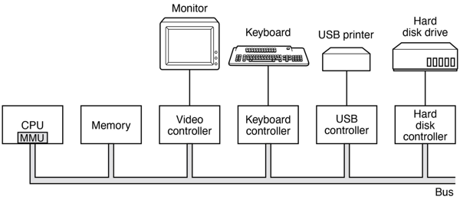
Device Controller
Located between actual device and computer
Offers electronic interface in form of I/O registers
R/W those registers to ask the controller to perform actions
Notes:
Long Description:
In the illustration, starting from the left, a C P U or M M U, a memory, a video controller, a keyboard controller, a U S B controlled, and a hard disk controller is all connected parallelly from left to right in a bus bar. The video controller is connected to a monitor separately from above. Likewise, the keyboard controller is connected to a keyboard, the U S B controller is connected to a U S B printer, and the hard disk controller is connected to a hard disk drive.

Slide 7
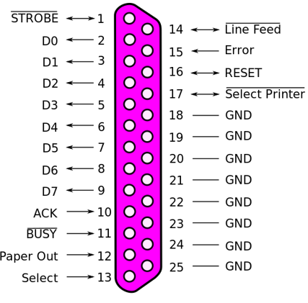
Example: Parallel Port
Notes:
Long Description:
The illustration shows the pin number and signals name as follows. 1, STROBE; 2, D 0; 3, D 1; 4, D 2; 5, D 3; 6, D 4; 7, D 5; 8, D 6; 9, D 7; 10, A C K; 11, BUSY; 12, Paper out; 13, select; 14, line feed; 15, error; 16, reset; 17, select printer; 18, G N D; 19, G N D; 20, G N D; 21, G N D; 22, G N D; 23, G N D; 24, G N D; 25, G N D.

Slide 8
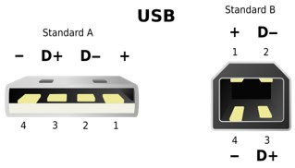
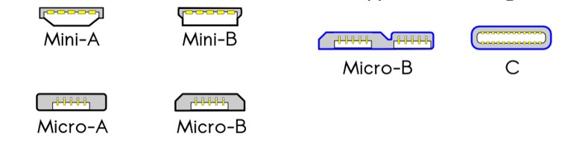
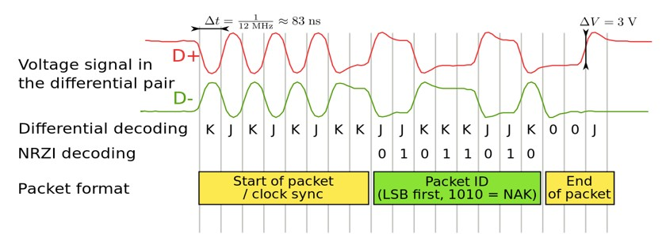
Example: U S B
Pin | Name | Cable color | Description
1 | V C C | Red | +5 V D C
0 | D- | White | Data -
3 | D+ | Green | Data +
4 | G N D | Black | Ground
Petteri Aimonen
Notes:
Long Description1:
The left illustration shows U S B Standard A. The pins are labeled from left to right as follows. Negative, 4; D positive, 3; D negative, 2; positive, 1. The right illustration shows U S B Standard B. The pins are labeled as follows. Positive, 1; D negative, 2; D positive, 3; negative, 4.
Long Description2:
The left side of the illustration shows U S B 1 point 0 dash 2 point 0. The labelings of different types of U S B are as follows. A, B, Mini-A, Mini-B, Micro-A, and Micro-B. The right side of the illustration shows U S B 3 point 0 dash 3 point 1. The labelings of different types of U S B are as follows. Micro-B and C.
Long Description3:
The illustration consists of the following fields. Voltage signal in the differential pair, differential decoding N R Z I decoding, packet format, the start of packet slash clock sync, the packet I D (L S B first, 1010 equals NAK), and end of packet. Voltage signal in the differential pair: a wave labeled D plus is a line becoming a regular sine wave with 3 cycles and becoming an irregular square waveform for two cycles and a line. The wavelength is delta t equals 1 over 12 M H z approximately equals 83 m s. Differential decoding N R Z I decoding: a wave labeled D minus is a line becoming a regular sine wave with 3 cycles and thereafter following the reverse trend of the wave of the voltage signal in the differential pair. Differential decoding: K; J; K; J; K; J; K; K; J; J; K; K; K; J; J; K; 0; 0; J. N R Z I decoding: blank; blank; blank; blank; blank; blank; blank; blank; 0; 1; 0; 1; 1; 0; 1; 0. Start of packet is till K; K of differential decoding, Packet I D is till J; J; K, and End of packet is 0 0 J.

Slide 9
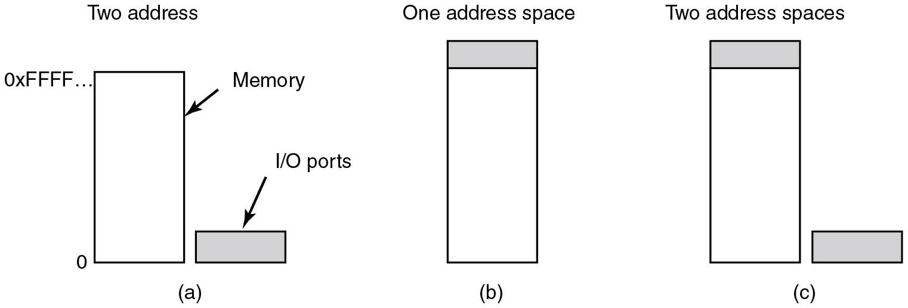
Accessing I/O Registers
Port-mapped I/O (P M I O)
I/O Registers are accessed via dedicated port numbers and special instructions
inb a x, 0x278 hash load value of I/O register
hash 0x278 to register a x
Figure 5.2 (a) Separate I/O and memory space.

Slide 10
Accessing I/O Registers
Memory-mapped I/O (M M I O)
I/O Registers are mapped into addresses of main memory and accessed like memory
mov 0x278, a x hash store value of a x
hash to address 0x278
Figure 5.2 (b) Memory-mapped I/O.

Slide 11
Accessing I/O Registers
Hybrid (P M M I O + M M I O)
Both implementation can coexist on a given architecture
Example: x86
Figure 5.2 (c) Hybrid.

Slide 12
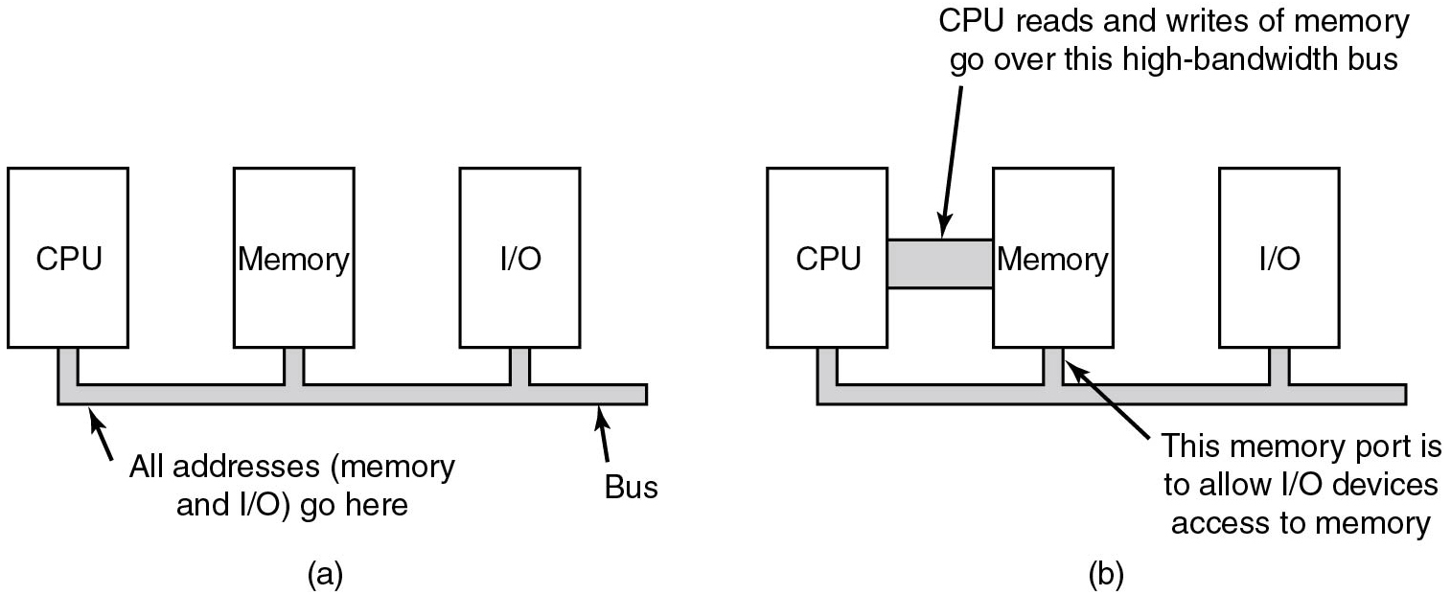
Memory-Mapped I/O
Figure 5.3 (a) A single-bus architecture. (b) A dual-bus memory architecture.
Notes:
Long Description:
Figure a: The blocks labeled C P U, Memory, and I slash O are arranged from left to right. Connection lines labeled all addresses (memory and I slash O) go here, from the bottom of each line are connected to a bus.
Figure b: The blocks labeled C P U, Memory, and I slash O are arranged from left to right and connected from the bottom to a bus. Here the C P U block and memory block is connected by a bus which is labeled C P U reads and writes of memory go over this high bandwidth bus. The text labeled This memory port is to allow I slash O devices access to memory points to the memory block.

Slide 13
P M I O Example (I B M P C)
Port range | Summary
0x0000-0x001F | The first legacy DMA controller, often used for transfers to floppies.
0x0020-0x0021 | The first Programmable Interrupt Controller
0x0040-0x0047 | The P I T (Programmable Interval Timer)
0x0060-0x0064 | The "8042" PS/2 Controller or its predecessors, dealing with keyboards and mice.
0x0070-0x0071 | The C M O S and RTC registers
0x0080-0x008F | The D M A (Page registers)
0x0092 | The location of the fast A20 gate register
0x00A0-0x00A1 | The second P I C
0x00C0-0x00D F | The second D M A controller, often used for sound blasters
0x0170-0x0177 | The secondary A T A hard disk controller.
0x01F0-0x01F7 | The primary A T A hard disk controller.
0x0278-0x027A | Parallel port
0x02F8-0x02FF | Second parallel port
0x03B0-0x03D F | The range used for the I B M V G A, its direct predecessors, as well as any modern video card in legacy mode.
0x03F0-0x03F7 | Floppy disk controller
0x03F8-0x03F F | First serial port
Notes:
Ken Thompson and Dennis Ritchie developed a simpler O S which they called UNICS (later: UNIX). Many students studied it, especially when John Lions published a line-by-line commentary of the source code. This comment is found in the source. It has become famous.
Image 1 from: https://cdn1.vogel.de/unsafe/fit-in/1000x0/images.vogel.de/vogelonline/bdb/1717400/1717458/original.jpg
Image 2 from: https://upload.wikimedia.org/wikipedia/commons/thumb/5/50/Lions_Commentary_Unix.jpeg/330px-Lions_Commentary_Unix.jpeg

Slide 14
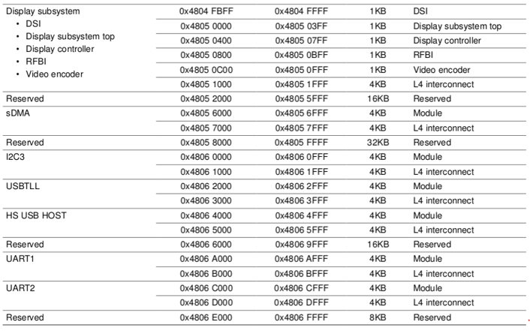
M M I O Example (O M A P 3)
Notes:
Ken Thompson and Dennis Ritchie developed a simpler OS which they called UNICS (later: UNIX). Many students studied it, especially when John Lions published a line-by-line commentary of the source code. This comment is found in the source. It has become famous.
Image 1 from: https://cdn1.vogel.de/unsafe/fit-in/1000x0/images.vogel.de/vogelonline/bdb/1717400/1717458/original.jpg
Image 2 from: https://upload.wikimedia.org/wikipedia/commons/thumb/5/50/Lions_Commentary_Unix.jpeg/330px-Lions_Commentary_Unix.jpeg
Long Description:
The table has 5 columns and 11 rows. The data are as follows: Row 1 is divided into 6 subrows. Row 1: Display subsystem; 0 times 4804 F B F F; 0 times 4804 F F F F; 1 K B; D S I. The subrows are as follows: Subrow 1: D S I; 0 times 4805 0000; 0 times 4805 03 F F; 1 K B; Display subsystem top. Subrow 2: Display subsystem top; 0 times 4805 0400; 0 times 4805 07 F F; 1 K B; Display controller. Subrow 3: Display controller; 0 times 4805 0800; 0 times 4805 0 B F F; 1 K B; R F B I. Subrow 4: R F B I; 0 times 4805 0 C 00; 0 times 4805 0 F F F; 1 K B; Video encoder. Subrow 5: Video encoder; 0 times 4805 1000; 0 times 4805 1 F F F; 4 K B; L 4 interconnect. Row 2: Reserved; 0 times 4805 2000; 0 times 4805 5 F F F F; 16 K B; Reserved. Row 2: Reserved; 0 times 4805 2000; 0 times 4805 5 F F F F; 16 K B; Reserved. Row 3 is divided into two subrows. Row 3 subrow 1: s D M A; 0 times 4805 6000; 0 times 4805 6 F F F; 4 K B; Module. Row 3 subrow 2: blank; 0 times 4805 7000; 0 times 4805 7 F F F; 4 K B; L 4 interconnect. Row 4: Reserved; 0 times 4805 8000; 0 times 4805 F F F F; 32 K B; Reserved. Row 5 has two subrows. Row 5 subrow 1: I 2 C 3; 0 times 4806 0000; 0 times 4806 0 F F F; 4 K B; Module. Row 6 subrow 2: blank; 0 times 4806 1000; 0 times 4806 1 F F F; 4 K B; L 4 interconnect. Rows 7 and 8 also have two subrows each. Row 7 subrow 1: U S B T L L; 0 times 4806 2000; 0 times 4806 2 F F F; 4 K B; Module. Row 7 subrow 2: blank; 0 times 4806 3000; 0 times 4806 3 F F F; 4 K B; L 4 interconnect. Row 8 subrow 1: H S U S B HOST; 0 times 4806 4000; 0 times 4806 4 F F F; 4 K B; Module. Row 8 subrow 2: blank; 0 times 4806 5000; 0 times 4806 5 F F F; 4 K B; L 4 interconnect. Row 9: Reserved; 0 times 4806 6000; 0 times 4806 9 F F F; 16 K B; Reserved. Rows 10 and 11 have two subrows each. Row 10 subrow 1: UART 1; 0 times 4806 A 000; 0 times 4806 A F F F; 4 K B; Module. Row 10 subrow 2: blank; 0 times 4806 B 000; 0 times 4806 B F F F; 4 K B; L 4 interconnect. Row 11 subrow 1: UART 2; 0 times 4806 C 000; 0 times 4806 C F F F; 4 K B; Module. Row 11 subrow 2: blank; 0 times 4806 D 000; 0 times 4806 D F F F; 4 K B; L 4 interconnect. Row 12: Reserved; 0 times 4806 E 000; 0 times 4806 F F F F; 8 K B; Reserved.

Slide 15
Quiz
What mechanism (P M I O versus. M M I O) is more flexible and efficient to implement device access control for unprivileged user processes?
A: M M I O because mapping a page containing I/O ports can be handled by the normal virtual memory system. To allow a user access to a device, just map its control page into the user’s address space

Slide 16
Waiting for I/O Requests Ellipsis
We can now send commands to devices, but what if the requested operation takes time?
Most devices offer status bits in their registers to signal that a request has been finished (and the error code)
O S can poll this status bit (polling)
Is this a good solution?
Notes:
Long Description:
Part (a): It is labeled as a three-stage pipeline. There are three blocks connected with each other with a forward arrow. The first block is labeled Fetch unit, the second block is labeled Decode unit and the third block is labeled Execute unit. Part (b): It is labeled as Superscalar C P U. There are seven square-shaped blocks and an ellipse-shaped block at the center of the square-shaped blocks. The first two top blocks are labeled as Fetch unit and Decode unit. Similarly, the bottom two blocks are labeled as Fetch unit and Decode unit. In the center, the ellipse-shaped block is labeled Holding buffer. Both Fetch units are connected to both Decode units with arrows and similarly, both decode units are connected with Holding buffer with the forward arrows. The Holding buffer is connected with the other three blocks labeled Execute unit placed on the right of the Holding buffer block.

Slide 17
Polling
For each byte of I/O
Read busy bit from status register until 0
Host sets read or write bit and if write copies data into data-out register
Host sets command-ready bit
Controller sets busy bit, executes transfer
Controller clears busy bit, error bit, command-ready bit when transfer done
Step 1 is busy-wait cycle to wait for I/O from device
Reasonable if device is fast
But inefficient if device slow
CPU switches to other tasks?
But if miss a cycle data overwritten / lost

Slide 18
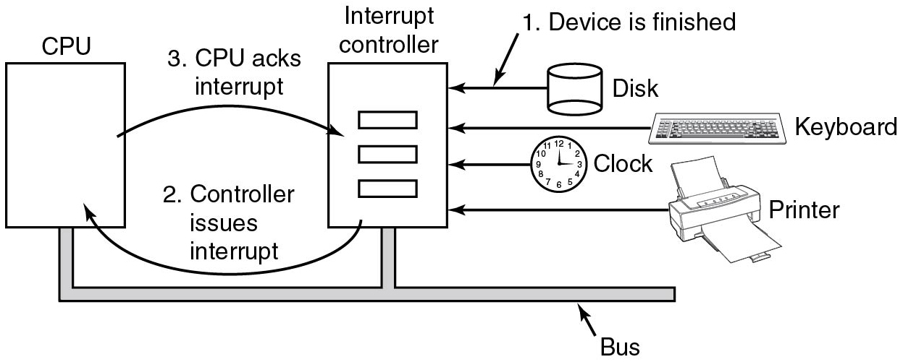
Interrupts
Device controller can trigger interrupts to signal that a I/O request is complete
For the device, this means simply changing the voltage on an electrical interrupt line
Each controller has interrupt vector assigned
C P U runs vector-specific handler when int occurs
Figure 5.4. Operation of a D M A transfer.
Notes:
Long Description:
The diagram has the blocks labeled C P U and interrupt controller and transfer devices. C P U and interrupt controller are connected in parallel in a bus bar. A forward arrow labeled 3. C P U acks interrupt is from C P U to interrupt controller. A reverse arrow labeled 2. Controller issues interrupt is from interrupt controller to C P U. Left arrows are from disk, keyboard, clock, and printer to interrupt controller. The left arrow from disk is labeled 1. Device is finished.

Slide 19
Data Exchange Between Device and C P U
How do we transfer data from e.g., hard disk to memory?
Program disk controller to read a sector
Wait for interrupt
Read sizeof(sector) bytes from I/O registers
Repeat for next sector
Is this a problem?
Yes! C P U cycles can be spent in a better way!
Notes:
Long Description:
Part (a): It is labeled as a three-stage pipeline. There are three blocks connected with each other with a forward arrow. The first block is labeled Fetch unit, the second block is labeled Decode unit and the third block is labeled Execute unit. Part (b): It is labeled as Superscalar C P U. There are seven square-shaped blocks and an ellipse-shaped block at the center of the square-shaped blocks. The first two top blocks are labeled as Fetch unit and Decode unit. Similarly, the bottom two blocks are labeled as Fetch unit and Decode unit. In the center, the ellipse-shaped block is labeled Holding buffer. Both Fetch units are connected to both Decode units with arrows and similarly, both decode units are connected with Holding buffer with the forward arrows. The Holding buffer is connected with the other three blocks labeled Execute unit placed on the right of the Holding buffer block.

Slide 20
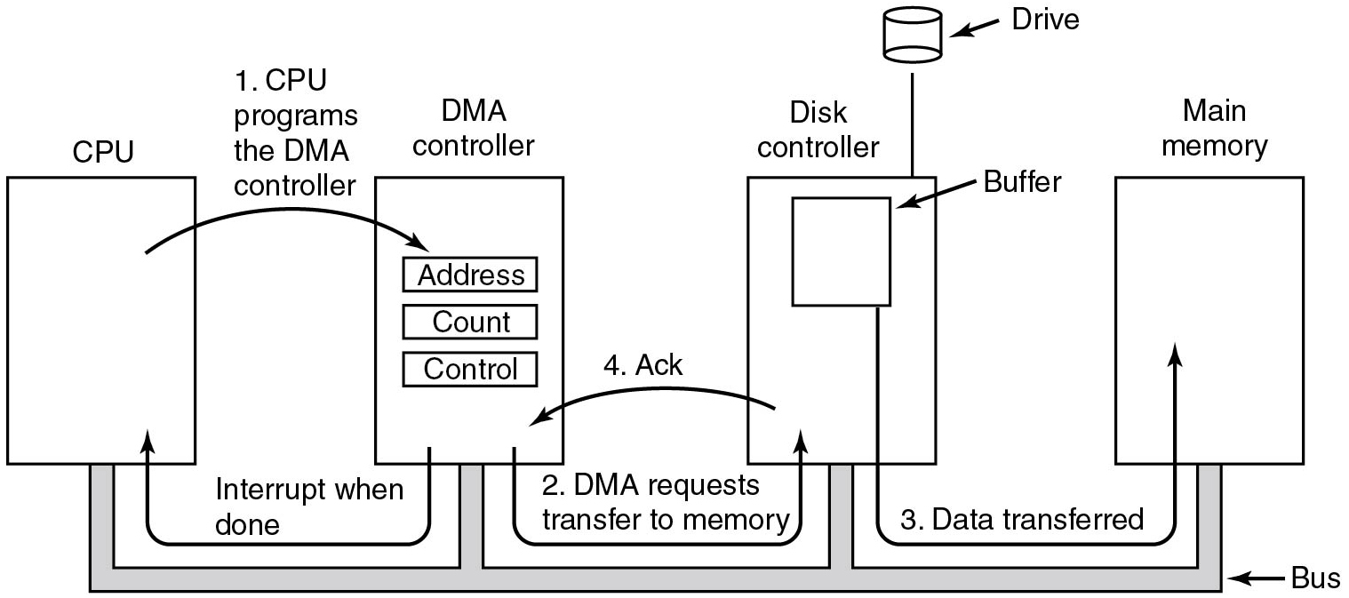
Direct Memory Access (D M A)
Solution:
Let the hardware do the transfer via D M A!
Figure 5.4 Operation of a D M A transfer.
Notes:
Long Description:
The figure consists of four blocks labeled C P U, D M A controller, Disk controller, and main memory connected from the bottom by a bus. The D M A controller block contains three sub-blocks labeled address, count, and control. An arrow labeled 1, C P U programs the D M A controller from C P U block points to the D M A controller block. Another arrow labeled 2, D M A requests transfer to memory points from D M A controller to the disk controller block. The disk controller contains a block labeled buffer which is connected to the main memory block using an arrow labeled 3, data transfer. A drive is also attached to the disk controller. An arrow from the disk controller points to the D M A controller labeled 4, Ack. Another arrow from the D M A controller points to the C P U labeled interrupt when done.

Slide 21
D M A Controller
On I S A systems there was a dedicated D M A controller (third-party D M A)
On P C I (and P C I e) systems each P C I device may become “Bus Master” and perform D M A (first-party D M A)
Device and D M A controller are combined
Do you see a problem here?
You have to trust your H W (or use a I/O M M U)
Note:
Embedded systems still have dedicated D M A controller
Disk controller still uses own buffers
Notes:
Long Description:
Part (a): It is labeled as a three-stage pipeline. There are three blocks connected with each other with a forward arrow. The first block is labeled Fetch unit, the second block is labeled Decode unit and the third block is labeled Execute unit. Part (b): It is labeled as Superscalar C P U. There are seven square-shaped blocks and an ellipse-shaped block at the center of the square-shaped blocks. The first two top blocks are labeled as Fetch unit and Decode unit. Similarly, the bottom two blocks are labeled as Fetch unit and Decode unit. In the center, the ellipse-shaped block is labeled Holding buffer. Both Fetch units are connected to both Decode units with arrows and similarly, both decode units are connected with Holding buffer with the forward arrows. The Holding buffer is connected with the other three blocks labeled Execute unit placed on the right of the Holding buffer block.

Slide 22
Quiz
You’re comparing the performance of two systems, both using no interrupts for device data transfer, but one using D M A + polling while the other system uses polling alone.
Q: Do you expect comparable or different performance for the two systems?
A: When D M A is used, the C P U can possibly do other work while the I/O is going on.

Slide 23
Overview
Principles of I/O Hardware
Principles of I/O Software
I/O Devices
Notes:
Long Description:
The image consists of two parts. Part (a): There are four square-shaped blocks labeled Core 1, Core 2, Core 3, and Core 4 placed at each corner inside a bigger square. There is a rectangle-shaped block labeled L2 cache placed between four blocks. All four blocks are connected with L 2 cache. Part (b): There are four square-shaped blocks labeled Core 1, Core 2, Core 3, and Core 4 placed at each corner inside a bigger square. The L 1 cache is placed in all four blocks in the top left corners of the blocks. The L 2 cache is placed in all four blocks in the lower right corners of the blocks. None of the blocks is connected.

Slide 24
Principles of I/O Software
Issues:
Device independence
Uniform naming
Error handling
Buffering
Synchronous versus asynchronous
Notes:
Long Description:
The image consists of two parts. Part (a): There are four square-shaped blocks labeled Core 1, Core 2, Core 3, and Core 4 placed at each corner inside a bigger square. There is a rectangle-shaped block labeled L2 cache placed between four blocks. All four blocks are connected with L 2 cache. Part (b): There are four square-shaped blocks labeled Core 1, Core 2, Core 3, and Core 4 placed at each corner inside a bigger square. The L 1 cache is placed in all four blocks in the top left corners of the blocks. The L 2 cache is placed in all four blocks in the lower right corners of the blocks. None of the blocks is connected.

Slide 25
Principles of I/O Software
Device independence
I/O software provides abstraction over actual hardware
Programs should not have to care about device particularities
Uniform naming
We don’t want to type S T6N M04 to address the first hard disk
/dev/sda is better
/mnt/movies even better
Error handling
Errors should be handled closest to their source
Notes:
Long Description:
The image consists of two parts. Part (a): There are four square-shaped blocks labeled Core 1, Core 2, Core 3, and Core 4 placed at each corner inside a bigger square. There is a rectangle-shaped block labeled L2 cache placed between four blocks. All four blocks are connected with L 2 cache. Part (b): There are four square-shaped blocks labeled Core 1, Core 2, Core 3, and Core 4 placed at each corner inside a bigger square. The L 1 cache is placed in all four blocks in the top left corners of the blocks. The L 2 cache is placed in all four blocks in the lower right corners of the blocks. None of the blocks is connected.

Slide 26
Principles of I/O Software
Buffering
Networking: incoming packets have to be buffered
Audio: buffering to avoid clicks
Synchronous versus. asynchronous I/O
Programs don’t want to deal with interrupts
O S
turns async operations into blocking operations
Lower levels have to deal with interrupts, D M A, etc.

Slide 27
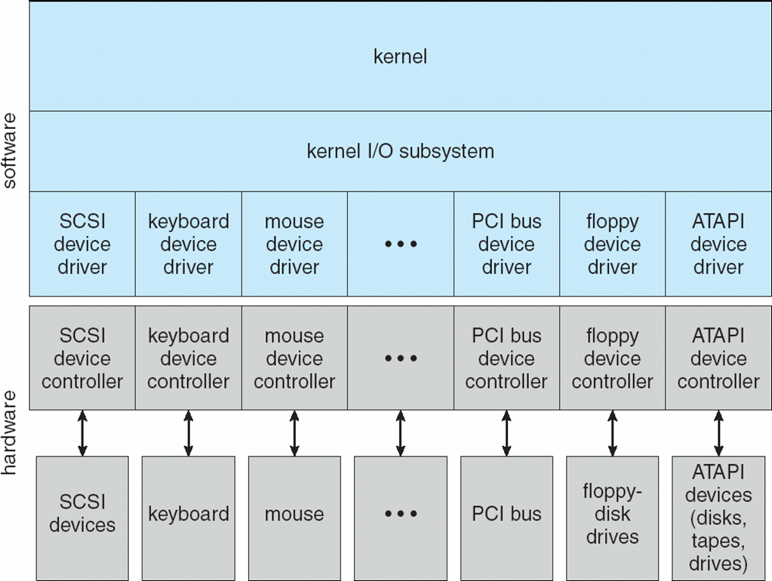
I/O Software Layers
Figure 5.11 Layers of the I/O software system.
Notes:
Long Description:
The figure consists of a block that is placed on another block labeled hardware. The first block is divided into four segments labeled from top to bottom as use level I O software, device-independent operating system software, device drivers, and interrupt handlers.

Slide 28
Interrupt Handlers
Typical steps after hardware interrupt completes:
Save registers not already saved by interrupt H W
Set up context for interrupt service procedure
Set up a stack for the interrupt service procedure
Acknowledge interrupt controller. If no centralized interrupt controller, re-enable interrupts
Copy registers from where saved to process table
Run interrupt service procedure. Typically, extract information from interrupting device controller’s registers. Often split into low-level interrupt service procedure (ran immediately) and high-level interrupt service procedure (scheduled later)
Choose which process to run next
Set up the M M U context for process to run next
Load new process’ registers,
Start running the new process
Notes:
Long Description:
There are rectangular blocks placed one above the other labeled Registers, Cache, Main memory, and Magnetic disk / S S D from top to bottom. The smallest block labeled Registers is at the top. There are two types of information labeled Typical access time on the upper left and Typical capacity on the upper right. Part 1. On the left: less than 1 nanosecond. On the right: less than 1 Kilobytes. On the left: 1 to 8 nanoseconds. On the right: 4 to 8 Megabytes. On the left: 10 to 50 nanoseconds. On the right: 16 to 64 gigabytes. On the left: 10 milliseconds backslash 10 seconds to 100 micro seconds. On the right: 2 to 16 plus terabytes. The 16 to 64 gigabytes and 2 to 16 plus terabytes are categorized as optional persistent memory.

Slide 29
Device Drivers
Accepts abstract requests from device-independent layer and transforms them into commands for the device
Can queue new requests as necessary
Usually needs to wait for the completion of the request (I R Q)
Checks for errors as necessary
Answers requests from device-independent layer
Notes:
Long Description:
There are rectangular blocks placed one above the other labeled Registers, Cache, Main memory, and Magnetic disk / S S D from top to bottom. The smallest block labeled Registers is at the top. There are two types of information labeled Typical access time on the upper left and Typical capacity on the upper right. Part 1. On the left: less than 1 nanosecond. On the right: less than 1 Kilobytes. On the left: 1 to 8 nanoseconds. On the right: 4 to 8 Megabytes. On the left: 10 to 50 nanoseconds. On the right: 16 to 64 gigabytes. On the left: 10 milliseconds backslash 10 seconds to 100 micro seconds. On the right: 2 to 16 plus terabytes. The 16 to 64 gigabytes and 2 to 16 plus terabytes are categorized as optional persistent memory.

Slide 30
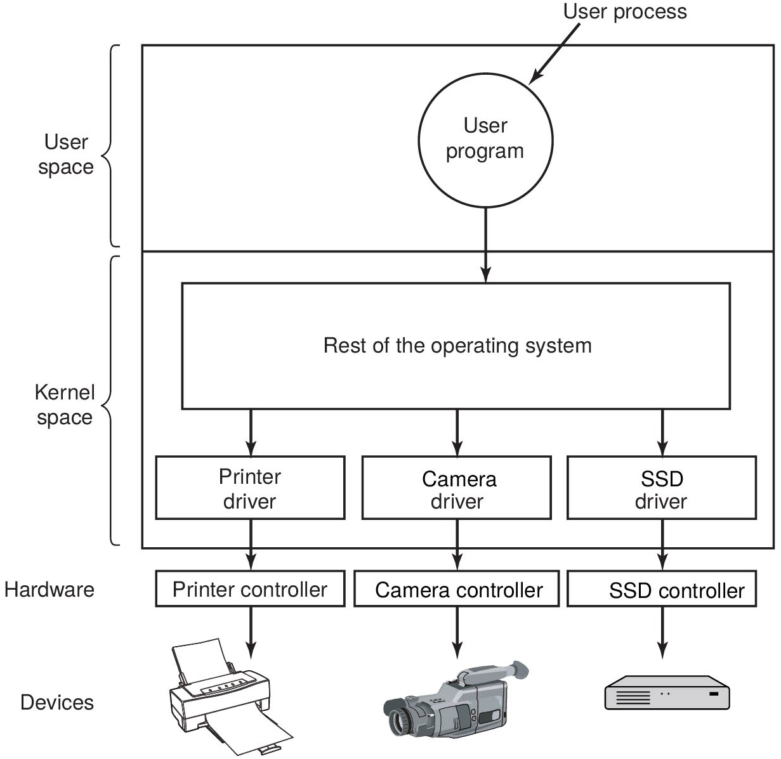
Device Drivers
Figure 5.12 Logical positioning of device drivers. In reality all communication between drivers and device controllers goes over the bus.
Notes:
Long Description:
The figure shows a block divided into two segments labeled user space and kernel space. The user space segment contains a circular block labeled user program which represents user process pointed to a block labeled rest of the operating system which is given inside the kernel space segment. From the rest of the operating system block, three arrows point to three blocks labeled printer driver, camera driver, S S D driver. Again three arrows from these blocks point to another three blocks which come under the hardware part labeled printer controller, camera controller, S S D controller. These three blocks are connected to the printer, camera, and S S D devices.

Slide 31
Device-Independent I/O Software
Uniform interfacing for device drivers
Driver interface, naming (e.g., major/minor numbers), protection
Buffering
Necessary for both character and block devices
Error reporting
Hardware-level, driver-level, etc.
Allocating and releasing dedicated devices
e.g., Printers
Providing a device-independent block size
Unify blocks/characters across devices

Slide 32
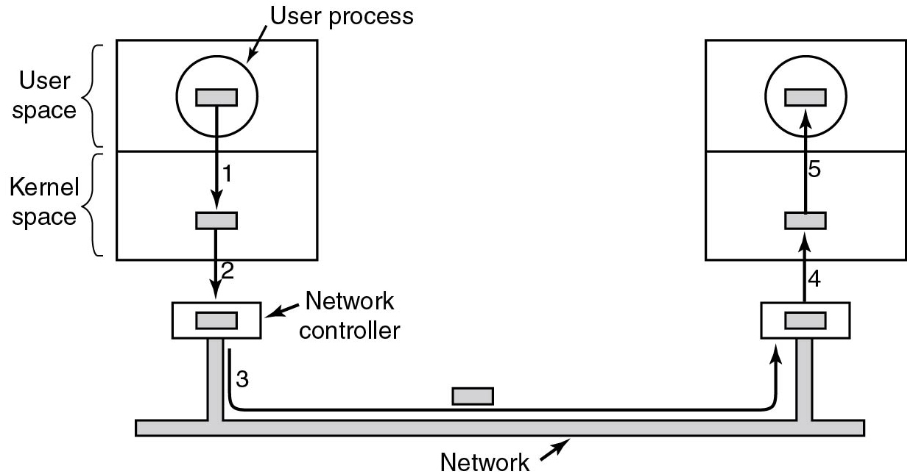
Buffering
Figure 5.16 Networking may involve many copies of a packet.
Notes:
Long Description:
The figure shows two blocks consisting of two segments labeled user space and kernel space placed at two ends and connected by a network. The user space segment of the left block contains a sub-block labeled user process which is pointed to another sub-block given inside the kernel space using an arrow 1. Another arrow labeled 2 points from this block points to a block labeled network controller and it is connected to another network controller placed below the right block using an arrow labeled 3. An arrow labeled 4 points from the right network controller to a block given inside the kernel space and again arrow 5 points from this sub-block to another block given inside the user space.

Slide 33
User-Level I/O Software
Offers a uniform interface to user to access devices
C standard I/O library
fopen, fclose, fflush, fprintf, etc
Safely multiplexes access to exclusive devices
E.g. Printing spooler

Slide 34
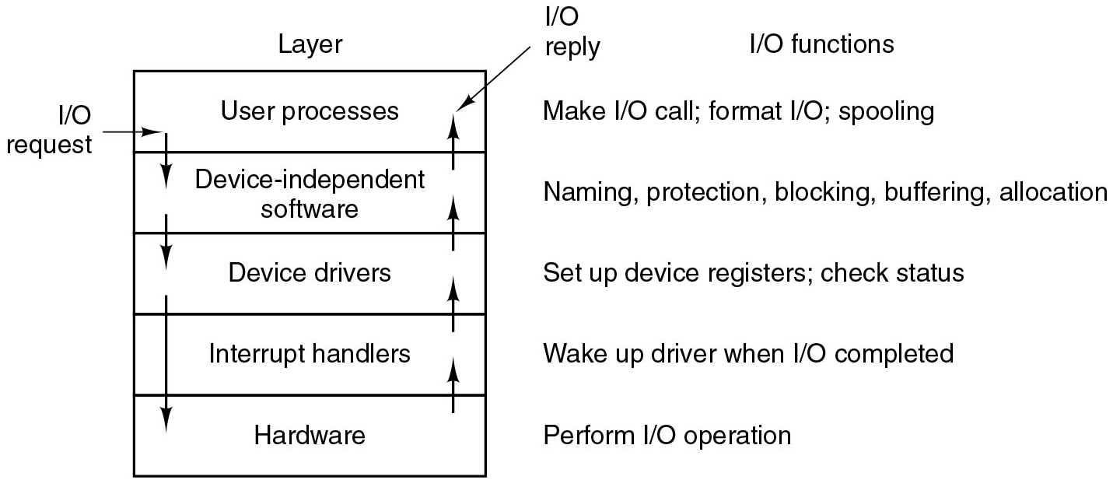
Layers of I/O Software
Figure 5.17 Layers of the I/O system and the main functions of each layer.
Notes:
Long Description:
The figure consists of a block labeled layer which is divided into five segments. The five segments are labeled from top to bottom as follows. User processes, Device-independent software, Device drivers, Interrupt handlers, and Hardware. Three arrows pointed downward starting from the first layer to the last layer sequentially are labeled I O request and another four arrows pointed upward from bottom to top layer are labeled I O reply.
The I O functions of each layer from top to bottom are labeled as follows. Layer 1: Make I O call; format I O; spooling. Layer 2: Naming, protection, blocking, buffering, allocation. Layer 3: Set up device registers; check status.
Layer 4: Wake up the driver when I O completed. Layer 5: Perform I O operation.

Slide 35
Overview (4 of 4)
Principles of I/O Hardware
Principles of I/O Software
I/O Devices

Slide 36
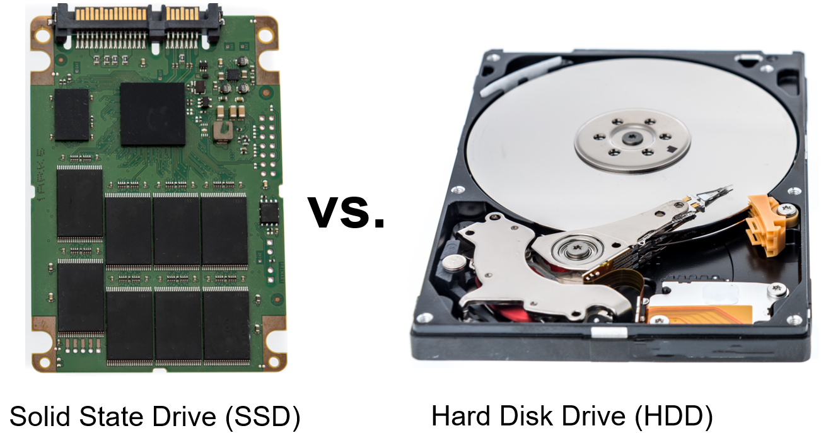
Storage Devices: S S D versus. H D D (1)
Keith Homan/Shutterstock
Notes:
Long Description:
The illustration compares a S S D and an H D D. The left illustration shows an opened S S D while the right illustration shows an opened H D D.

Slide 37


Storage Devices: S S D versus. H D D
Blank | S S D | H D D
Power | A green tick mark sign. | A red cross mark.
Heat | A green tick mark sign. | A red cross mark.
Noise | A green tick mark sign. | A red cross mark.
Vibration | A green tick mark sign. | A red cross mark.
Weight | A green tick mark sign. | A red cross mark.
Durability | A green tick mark sign. | A red cross mark.
Speed | A green tick mark sign. | A red cross mark.
Cost | A red cross mark. | A green tick mark sign.
Capacity | A red cross mark. | A green tick mark sign.

Slide 38
Solid-State Drive (S S D)
D R A M or N O R/N A N D flash memory based
No mechanical parts (only controller+mem)
Can be used as part of S S H D s
N A N D flash memory
Organized in cells pages, blocks
Controller can read/program at page granularity
Controller can erase at block granularity
R N D/S E Q access latency comparable
Reads more efficient than writes
Wear leveling to improve write endurance
Garbage collection to implement write operations

Slide 39
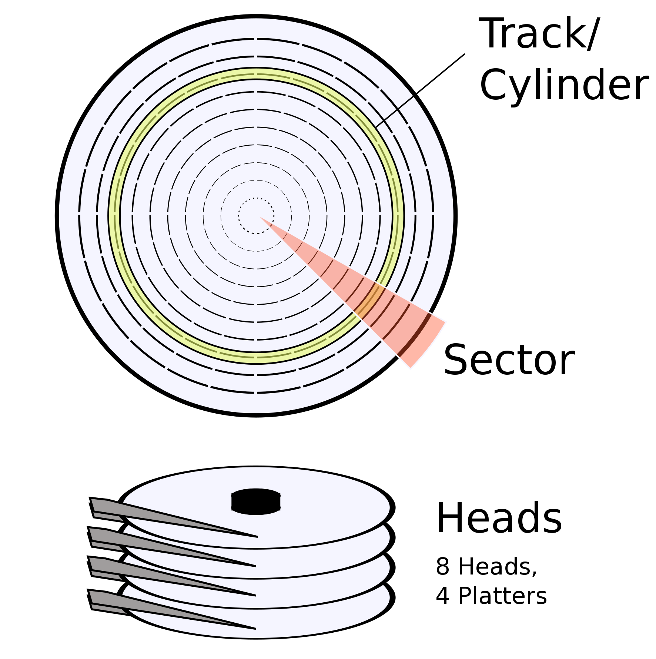
Hard Disk Drive (H D D)
Multiple platters and cylinders in a single disk with as many tracks as their heads. Each
track
N sectors
Addressing modes:
C H S (Cylinder-head-sector), virtual/physical
L B A (Logical Block Addressing), virtual
LionKimbro
Notes:
Long Description:
The Top illustration shows a diagram of multiple concentric circles. A yellow circle among the concentric circles is labeled as track slash cylinder. A red highlighted area is labeled as sector. The Bottom illustration shows heads of a hard disk drive. It is labeled as 8 heads, 4 platters.

Slide 40
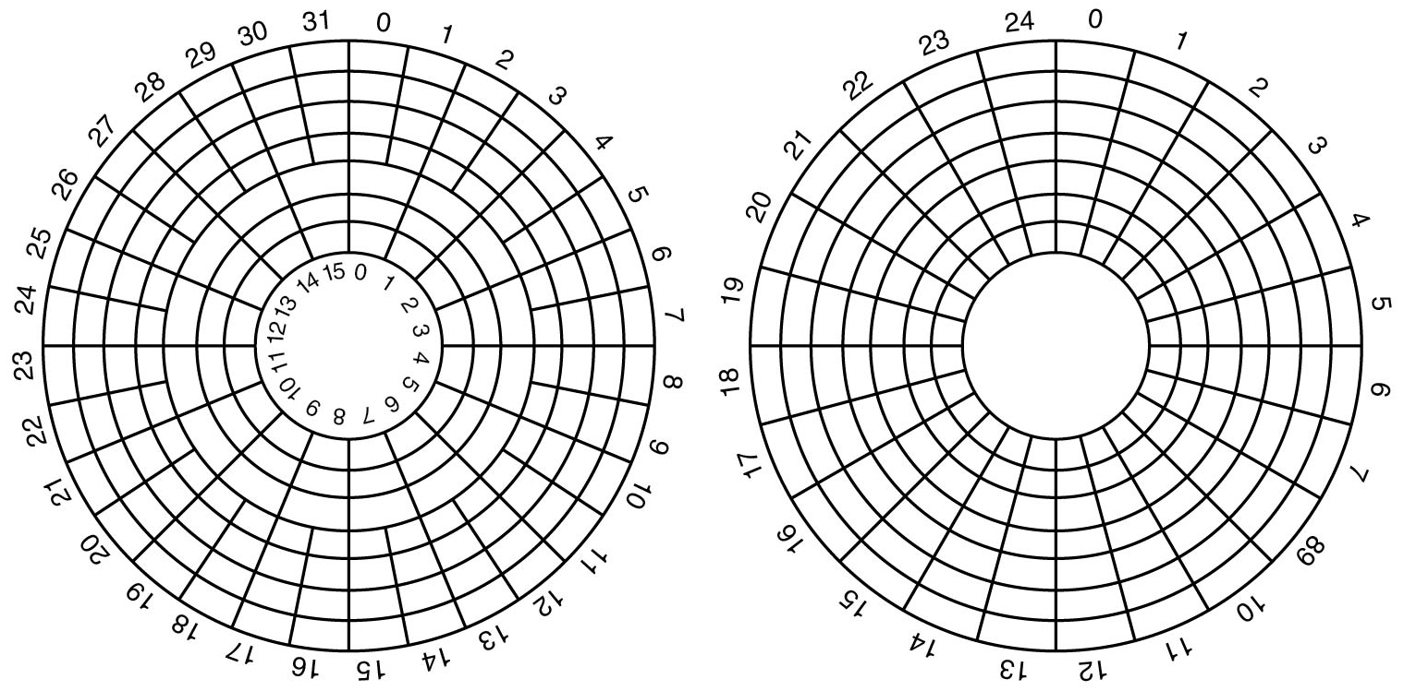
Hard Disk Geometry
Figure 5.18 (a) Physical geometry of a disk with two zones. (b) A possible virtual geometry for this disk.
Notes:
Long Description:
Figure a: The disk contains 8 rings and is divided into two zones. The outer zone contains five rings and is divided into 32 sectors labeled from 0 to 31. The inner zone contains 3 rings and is divided into 16 sectors labeled from 0 to 15.
Figure b: Here the disk contains 8 rings and is divided into 25 sectors labeled from 0 to 24.

Slide 41
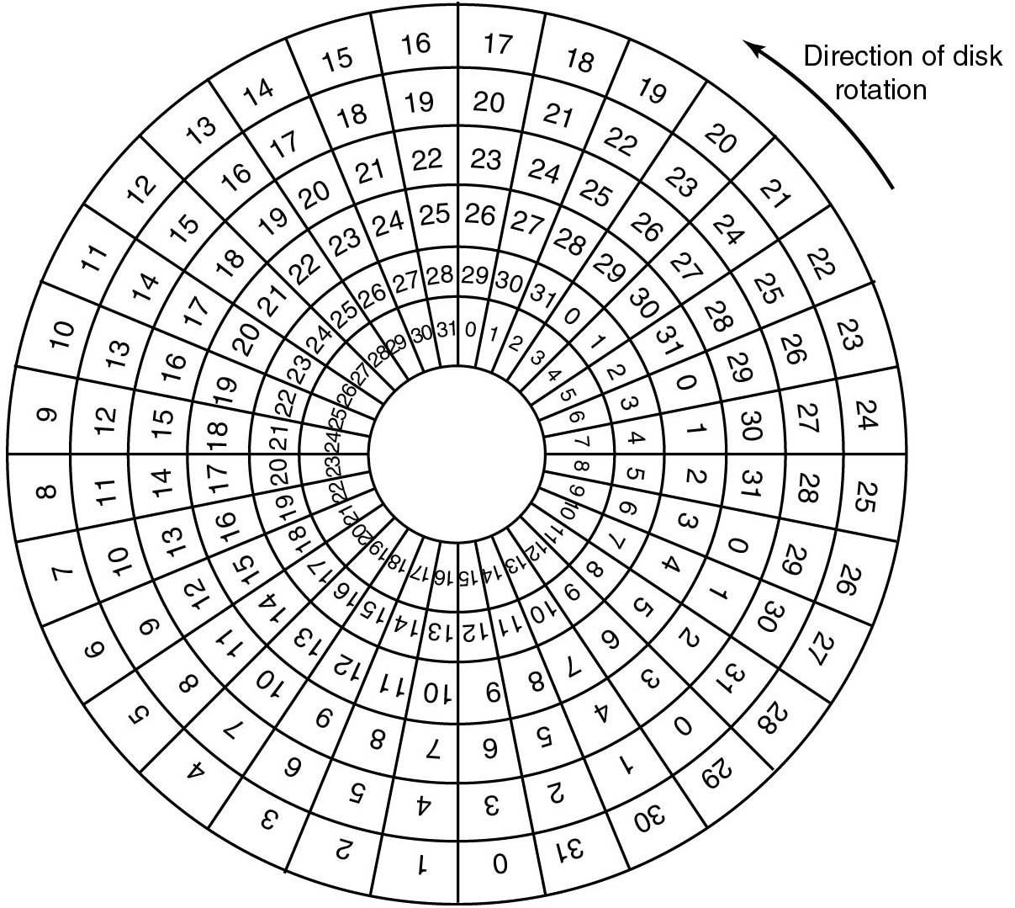
Disk Formatting
Figure 5.20 An illustration of cylinder skew.
Notes:
Long Description:
The figure illustrates a disk rotating in a counterclockwise direction and consisting of seven rings. The 8 rings are divided into 32 sectors. The outer ring is labeled from 0 to 31 starting from the bottom and each inner ring is labeled 0 to 31, three sectors right of the outer ring.

Slide 42
Hard Disk: Block Read/Write Time
Factors determining disk block read/write time:
Seek time
The time to move the arm to the proper cylinder
Rotational delay
The time for the sector to come under the head
Data transfer time
The time to transfer a single block
Which one dominates the read/write time? Seek time
How do we minimize it and where? Sort requests by cylinder number

Slide 43
Disk Scheduling
The operating system is responsible for using hardware efficiently — for the disk drives, this means having a fast access time and disk bandwidth
Minimize seek time
Seek time ≈ seek distance
Disk bandwidth is the total number of bytes transferred, divided by the total time between the first request for service and the completion of the last transfer

Slide 44
Disk Scheduling (Cont.)
Note that drive controllers have small buffers and can manage a queue of I/O requests (of varying “depth”)
Several algorithms exist to schedule the servicing of disk I/O requests
The analysis is true for one or many platters
We illustrate scheduling algorithms with a request queue (0-199)
98, 183, 37, 122, 14, 124, 65, 67
Head pointer 53

Slide 45
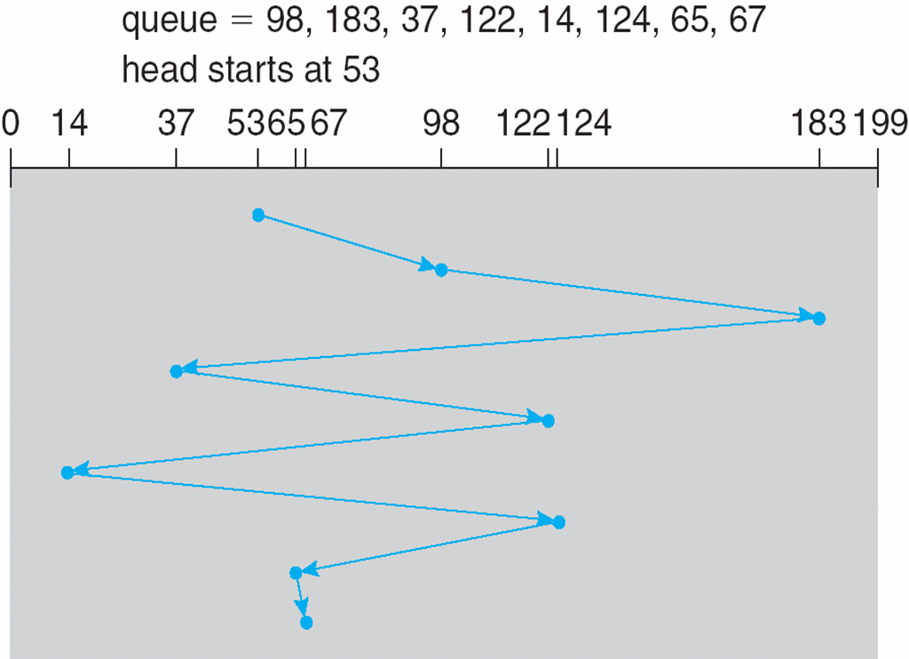
FCFS
Illustration shows total head movement of 640 cylinders

Slide 46
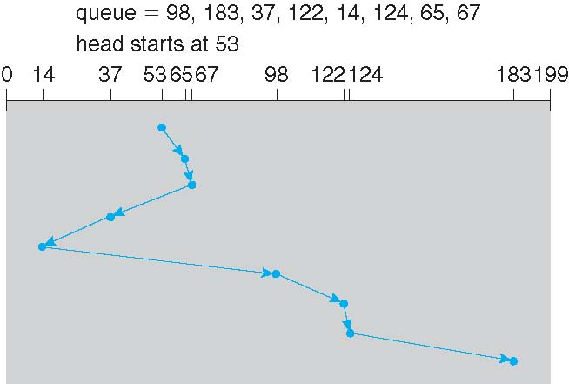
SSTF
Shortest Seek Time First selects the request with the minimum seek time from the current head position
SSTF scheduling is a form of SJF scheduling; may cause starvation of some requests
Illustration shows total head movement of 236 cylinders

Slide 47
SCAN
The disk arm starts at one end of the disk, and moves toward the other end, servicing requests until it gets to the other end of the disk, where the head movement is reversed and servicing continues.
SCAN algorithm Sometimes called the elevator algorithm
Illustration shows total head movement of 236 cylinders
But note that if requests are uniformly dense, largest density at other end of disk and those wait the longest

Slide 48
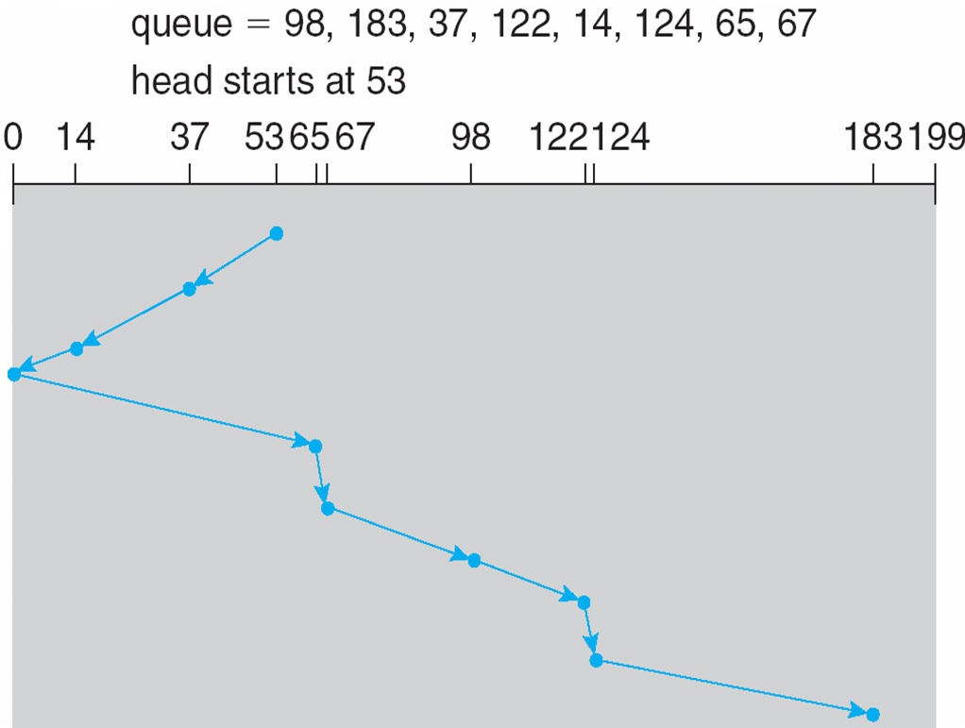
SCAN (Cont.)

Slide 49
C-SCAN
Provides a more uniform wait time than SCAN
The head moves from one end of the disk to the other, servicing requests as it goes
When it reaches the other end, however, it immediately returns to the beginning of the disk, without servicing any requests on the return trip
Treats the cylinders as a circular list that wraps around from the last cylinder to the first one
Total number of cylinders?

Slide 50
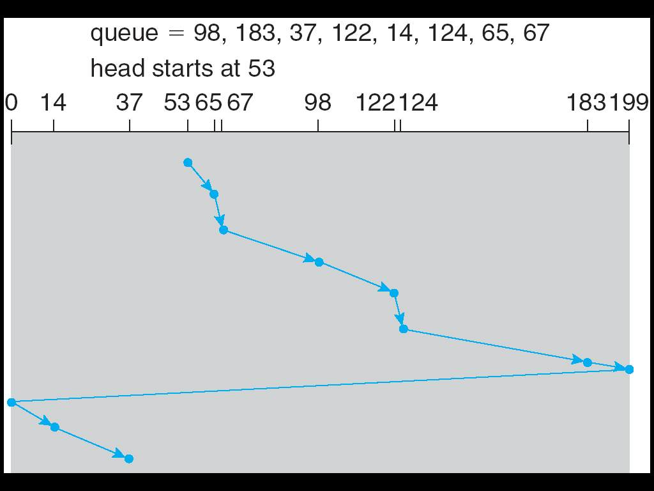
C-SCAN (Cont.)

Slide 51
C-LOOK
LOOK a version of SCAN, C-LOOK a version of C-SCAN
Arm only goes as far as the last request in each direction, then reverses direction immediately, without first going all the way to the end of the disk
Total number of cylinders?

Slide 52
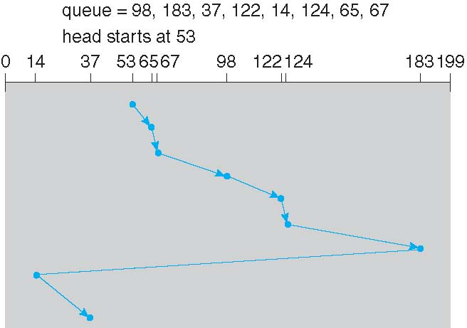
C-LOOK (Cont.)

Slide 53
Selecting a Disk-Scheduling Algorithm
SSTF is common and has a natural appeal
SCAN and C-SCAN perform better for systems that place a heavy load on the disk
Less starvation
Performance depends on the number and types of requests
Requests for disk service can be influenced by the file-allocation method
And metadata layout
The disk-scheduling algorithm should be written as a separate module of the operating system, allowing it to be replaced with a different algorithm if necessary
Either SSTF or LOOK is a reasonable choice for the default algorithm
What about rotational latency?
Difficult for OS to calculate
How does disk-based queueing effect OS queue ordering efforts?

Slide 54
Hard Disk: Error Handling
Programming Errors
e.g., request for nonexistent sector
Transient Errors
e.g., caused by dust on the head
Permanent Errors
e.g., disk block physically damaged
Seek Errors
e.g., the arm was sent to cylinder 6 but it went to 7
Controller Errors
e.g., controller refuses to accept commands

Slide 55
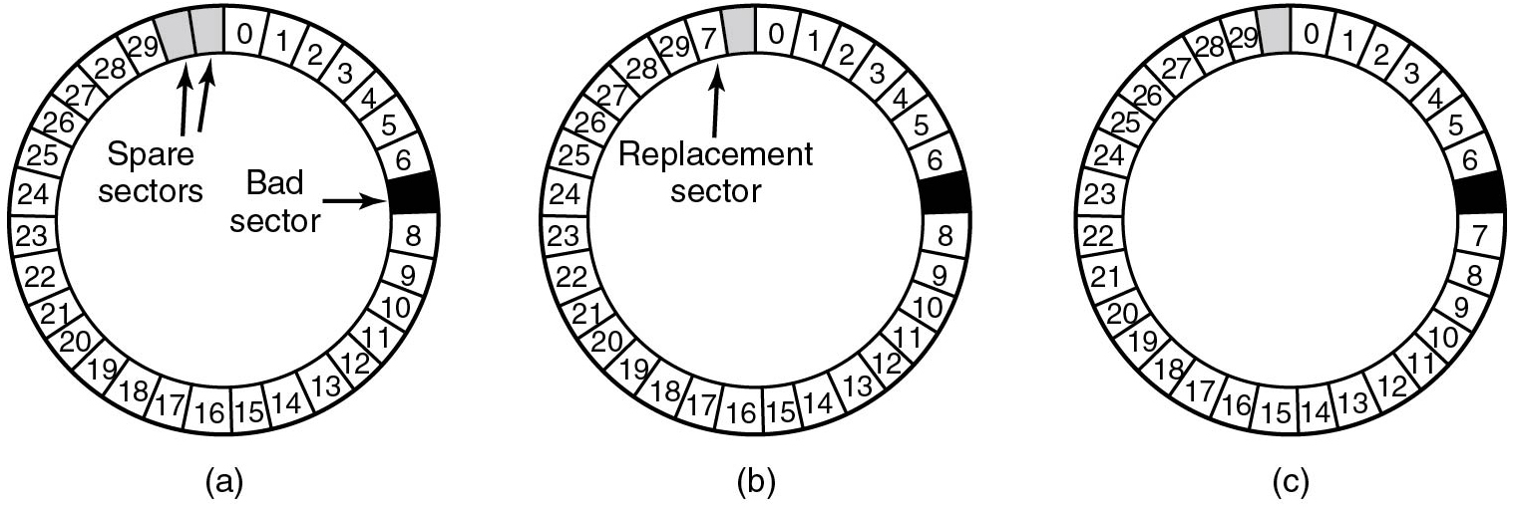
Hard Disk: Bad Sector Remapping
Figure 5.24 (a) A disk track with a bad sector. (b) Substituting a spare for the bad sector. (c) Shifting all the sectors to bypass the bad one.
Notes:
Long Description:
The figure shows three disks divided into 31 segments.
Figure a: The segments are labeled 0 to 29 from the top in a clockwise direction. The seventh segment is left empty and shaded in dark and labeled bad sector. Segments 30 and 31 are also left empty and shaded in a light color and labeled space sector.
Figure b: The segments are labeled 0 to 29 from the top in a clockwise direction. The seventh segment is left empty and shaded in dark. Segments 30 is labeled 7 and segment 31 is left empty and shaded in a light color.
Figure c: The segments are labeled from the top in a clockwise direction as follows, 0 to 6, then blank, 7 to 29, then blank. The first blank segment is shaded in dark color and the second blank segment is shaded in a light color.

Slide 56
Clock Hardware
Two types:
Simple clocks deliver hardware interrupts for each voltage cycle of the power supply (i.e., every 20 or 16.7 m s)
Advanced programmable clocks that have own crystal oscillator that decrements a counter in a register.
If counter hits zero
H W interrupt
H W also provides “counters” S W can read as needed

Slide 57
Clock Software
Typical duties of a clock driver:
Maintaining the time of day
System boot time (backup clock) + uptime (ticks)
Preventing processes from running longer than allowed
Decrement current process' quantum at each tick
Accounting for C P U usage
Increment current process’ c p u time at each tick
Handling alarm system call from user processes
Decrement alarm counter at each tick
Providing watchdog timers for parts of system itself
Generate sys notifications for synchronous alarms
Profiling, monitoring, statistics gathering
Increment specific counters at each tick

Slide 58
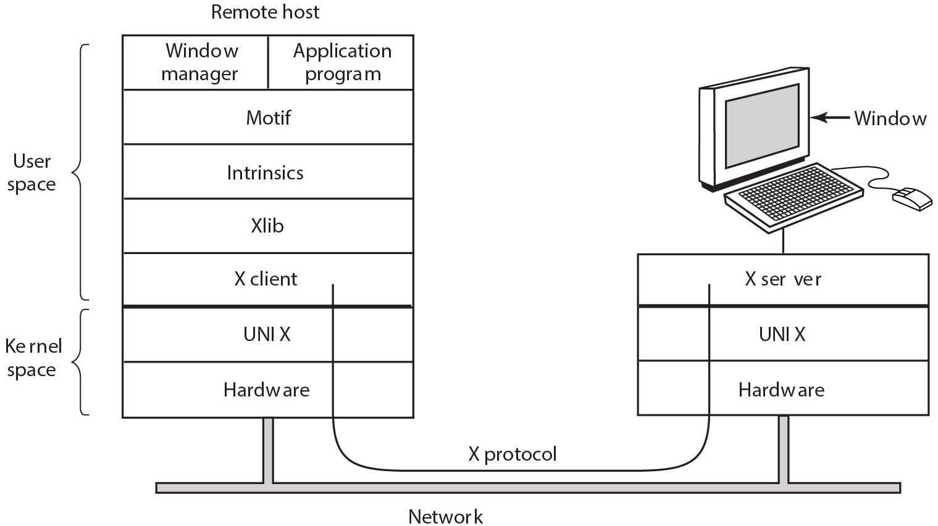
The X Window System
Figure 5.33 Clients and servers in the M.I.T. X Window System.
Notes:
Long Description:
The figure shows a block labeled remote host which consists of seven rows. The first five rows are labeled user space and the remaining two rows are labeled kernel space. The first row consists of two columns labeled window manager, application program. The remaining rows are labeled from top to bottom as follows. Motiff, Intrinsic, Xlib, X client, UNIX, hardware. Another block is given next to the remote host block which contains three rows labeled X server, UNIX, and hardware. This block is connected to a computer that has a window. The two blocks are connected by a network. The X client of the first block is connected to the X server of the second block.

Slide 59
Modern Operating Systems
Fifth Edition
Chapter 5
Input /Output
Copyright © 2023, 2014, 2008 Pearson Education, Inc. All Rights Reserved
Notes:
If this PowerPoint presentation contains mathematical equations, you may need to check that your computer has the following installed:
1) Math Type Plugin
2) Math Player (free versions available)
3) NVDA Reader (free versions available)

